Slide 1
Georgia Access Plan Year (PY) 2025 Certified Application Counselor Designated Organization (CDO) Application

Slide 2
Housekeeping rules
Georgia Access Plan Year (PY) 2025 Certified Application Counselor Designated Organization (CDO) Application
Use the CHAT as a backchannel for questions and comments & to participate in activities
Remain on MUTE when you’re not speaking. Unmute yourself only when you want to speak
This session is being recorded. The recording, a transcript, and the saved chat will be made available on Georgia Access website as soon as possible after the session.

Slide 3
AGENDA
Georgia Access Plan Year (PY) 2025 Certified Application Counselor Designated Organization (CDO) Application
Overview
Certified Application Counselor Designated Organization
Individual Certified Application Counselor
Georgia Access Certified Application Counselor Designated Organization Application Form
Upcoming Dates
Q&A Section

Slide 4
Overview
Georgia Access Plan Year (PY) 2025 Certified Application Counselor Designated Organization (CDO) Application
Senate Bill 65 was signed into law by Governor Kemp on May 2, 2023, granting Georgia the authority to establish and operate a State-based Exchange (SBE). Georgia received CMS approval to operate as an SBE on the Federal Platform (SBE-FP) for PY 2024 and as an SBE for PY 2025. For Open Enrollment (OE) 2025 beginning November 1, 2024, Georgia will operate solely as an SBE.
Georgia Access State-based Exchange is designed to meet the needs of Georgia residents by increasing access to affordable and quality health insurance coverage. The SBE will replicate the federal Exchange model with multiple enrollment options for consumers, including a state consumer portal, certified agents, and direct enrollment through insurance companies or web-brokers certified as Georgia Access Enrollment Partners.
Georgia Access is operating a CAC Program in accordance with 45 CFR § 155.225. Georgia’s approach for its CAC Program is based on the CMS model. Organizations must apply for and be approved to operate a CAC Program. Once approved, organizations are designated as Certified Application Counselor Designated Organizations (CDOs). CDOs are responsible for overseeing affiliated CACs and providing quarterly reports to the State.
The PY2025 performance period will be 12 months, beginning September 1, 2024, and ending December 2025. Approved CDO’s will be required to sign the CDO Agreement prior to September 1, 2024.

Slide 5
Certified Application Counselor Designated Organization (CDO)
Georgia Access Plan Year (PY) 2025 Certified Application Counselor Designated Organization (CDO) Application

Slide 6
Certified Application Counselor Designated Organization
Georgia Access Plan Year (PY) 2025 Certified Application Counselor Designated Organization (CDO) Application
Retains the primary responsibility of overseeing CAC activities and ensuring individual CACs meet program requirements
Comply with all applicable federal and state laws
Comply with all requests from the State for additional information
Ensure SBE requirements for CACs and CDOs are upheld
Provide required data and reports on a quarterly basis to the State
Are expected to share information and marketing materials about Georgia Access with the public to increase awareness of health insurance options available

Slide 7
Certified Application Counselor Designated Organization eligible organizations
Georgia Access Plan Year (PY) 2025 Certified Application Counselor Designated Organization (CDO) Application
Nonprofit organizations that have a 501(c)(3) status with the IRS
Local government agencies and special districts
Education organizations
Public housing organizations
City or county governments
Native American tribal governments or organizations
Independent school districts
Institutions of higher education
Public housing authorities
Small, medium, or large for-profit businesses
Community and consumer-focused groups
Trade, industry, and professional associations
Commercial fishing industry organizations
Ranching and farming organizations
Chambers of commerce
Unions
Resource partners of the Small Business Administration (SBA)
Hospitals and health centers
Health care provider groups
Libraries

Slide 8
Certified Application Counselor Designated Organization ineligible organizations
Georgia Access Plan Year (PY) 2025 Certified Application Counselor Designated Organization (CDO) Application
Health insurance companies or their subsidiaries
Insurance companies of stop loss insurance and their subsidiaries
Associations that include members of, or lobby on behalf of, the insurance industry
Insurance agents, insurance agencies, or recipients of any direct or indirect consideration from any insurance issuer in connection with the enrollment in a health or dental plan
Other organizations determined by the State to have a conflict of interest

Slide 9
Individual Certified Application Counselor (CAC)
Georgia Access Plan Year (PY) 2025 Certified Application Counselor Designated Organization (CDO) Application

Slide 10
Individual Certified Application Counselor (CAC)
Georgia Access Plan Year (PY) 2025 Certified Application Counselor Designated Organization (CDO) Application
CACs are individuals who are certified and licensed by the State to support consumers with applying for health coverage on Georgia Access. CACs are required to be affiliated with a CDO, either as employees or volunteers. CACs must maintain strict privacy and security standards while assisting consumers.
CACs are required to support any consumer seeking enrollment assistance. This requirement applies even if that consumer is not a member of the communities or groups the applicant expects to target, as outlined in its CDO Application.
All individuals carrying out CAC functions must obtain a Georgia Access Specialist Licensure and Georgia Access Certification before assisting consumers. CACs can begin the Georgia Access Specialist Licensure process at any point, but they must obtain Georgia Access Certification before completing the licensure process. Licensure requirements are outlined on the OCI website and Georgia Access Certification requirements are outlined on the Georgia Access website.

Slide 11
Individual Certified Application Counselor (CAC)
Georgia Access Plan Year (PY) 2025 Certified Application Counselor Designated Organization (CDO) Application
CACs are expected to perform the following activities:
Provide unbiased support for consumers by remaining free of conflicts of interest
Educate consumers on basic healthcare concepts, coverage options, and available financial assistance on Georgia Access
Support consumers with applying on Georgia Access
Support consumers in understanding their eligibility results and next steps
Provide consumers with language interpretation support
Provide consumers with accessibility support
Refer consumers to the Georgia Access Contact Center, as appropriate
Help consumers find certified agents, as appropriate
Provide information on Medicaid and PeachCare for Kids®, as appropriate

Slide 12
Individual Certified Application Counselor (CAC)
Georgia Access Plan Year (PY) 2025 Certified Application Counselor Designated Organization (CDO) Application
CACs are prohibited from performing the following activities:
Recommend specific health insurance plans for consumers
Enroll a consumer into a health insurance plan
Provide gifts to a consumer to incentivize enrollment
Impose fees for providing consumer support and assistance
Request or receive compensation from consumers or third parties for assistance
Request or receive compensation from insurance companies
Request or receiving compensation from agents for consumer referrals
Act as an intermediary between an employer and health insurance company
Call consumers to offer assistance without the consumer initiating contact first
Use an automatic telephone dialing system or an artificial or prerecorded voice
Solicit any consumer for an application or enrollment assistance by going door-to-door or through unsolicited means of direct contact.
Provide gifts of any value to an applicant or potential enrollee as an inducement for enrollment.

Slide 13
Certified application counselor application review
Georgia Access Plan Year (PY) 2025 Certified Application Counselor Designated Organization (CDO) Application
Applicants are required to complete all sections of the Certified Application Counselor Application
Applications determined to be ineligible or incomplete will be eliminated from review
The State reserves the right to contact applicants for additional information if needed
Applications will be reviewed and evaluated for completeness, accuracy, and thoroughness, but will not be formally scored
Notes:
Make sure to complete all sections of the application , applications determined to be ineligible or incomplete will be eliminated from review. If something is unclear or needs additional clarification the state reserves the right to contact applicants

Slide 14
Georgia Access Certified Application Counselor Designated Organization (CDO) Application Form
Georgia Access Plan Year (PY) 2025 Certified Application Counselor Designated Organization (CDO) Application

Slide 15
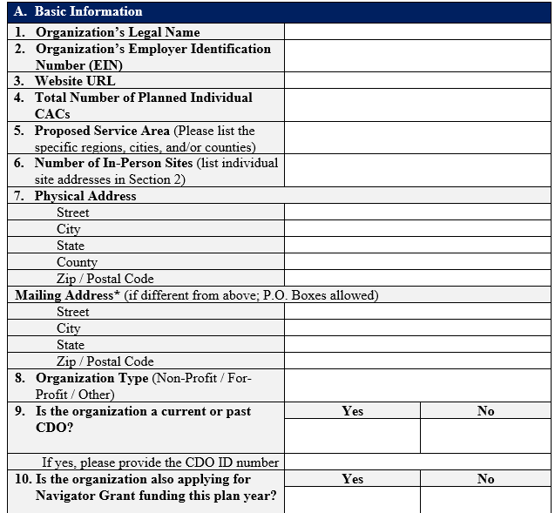
Georgia Access CDO Application Form
Section 1: Applicant Information
Basic Information
Application Point of Contact

Slide 16
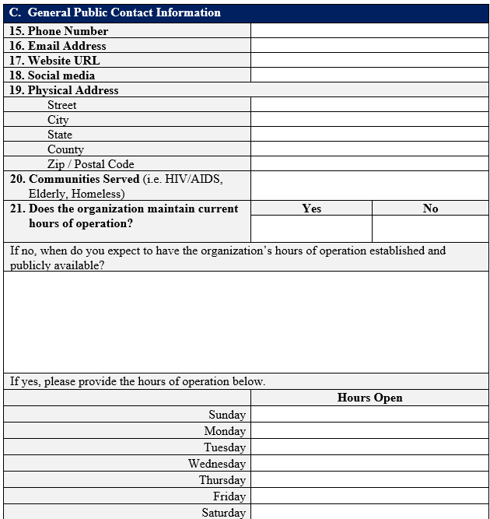
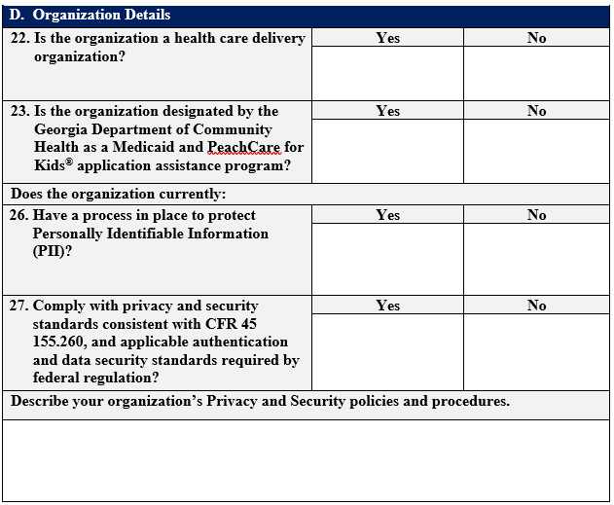
Georgia Access CDO Application Form
Section 1: Applicant Information
C. General Public Contact Information
D. Organization Details

Slide 17
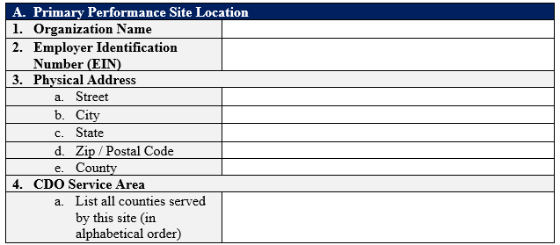
Georgia Access CDO Application Form
Section 2: Project Site(s)
Primary Performance Site Location

Slide 18
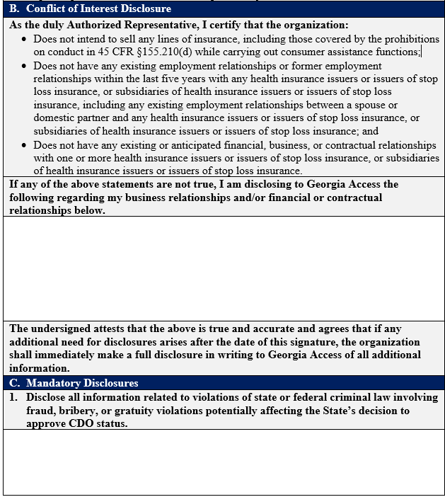
Georgia Access CDO Application Form
Section 3: Attestations & Signature
OCI Reporting
Conflict of Interest Disclosure
Mandatory Disclosures

Slide 19
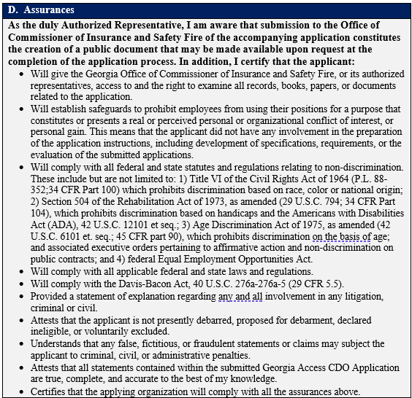
Georgia Access CDO Application Form
Section 3: Attestations & Signature
D. Assurance
E. Authorized Representative

Slide 20
Key Dates
Georgia Access Plan Year (PY) 2025 Certified Application Counselor Designated Organization (CDO) Key dates
June 3, 2024
CDO Application release
CDO Applications due
Approved CDOs announcement
Sep. 24, 2024
June 24, 2024
CDO Application webinar
July 15, 2024 & ongoing
July 30, 2024
CACs FAQ’s availability on Georgia Access website
July 31, 2024
CACs Certification Training release
Aug. 12, 2024
CACs Informational Session

Slide 21
Questions and Answers
For additional questions about the Georgia Access CAC Program, reach out to CDOs@GeorgiaAccess.ga.gov

